Slide 1
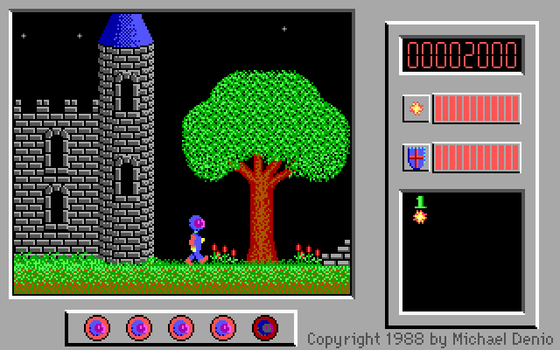
Captain comic with deep neural networks
Old jump and run adventure
Traits: sideways tiles, shooting , branched game

Slide 2
Project-Focus
No Data sets around
mainfocus: interactive environment ann-to-game, reward-model

Slide 3
Related works
Playing Atari with Deep Reinforcement Learning https://arxiv.org/pdf/1312.5602.pdf
CS229 Final Report Deep Q-Learning to Play Mario http://cs229.stanford.edu/proj2016/report/klein-autonomousmariowithdeepreinforcementlearning-report.pdf

